Slide 1
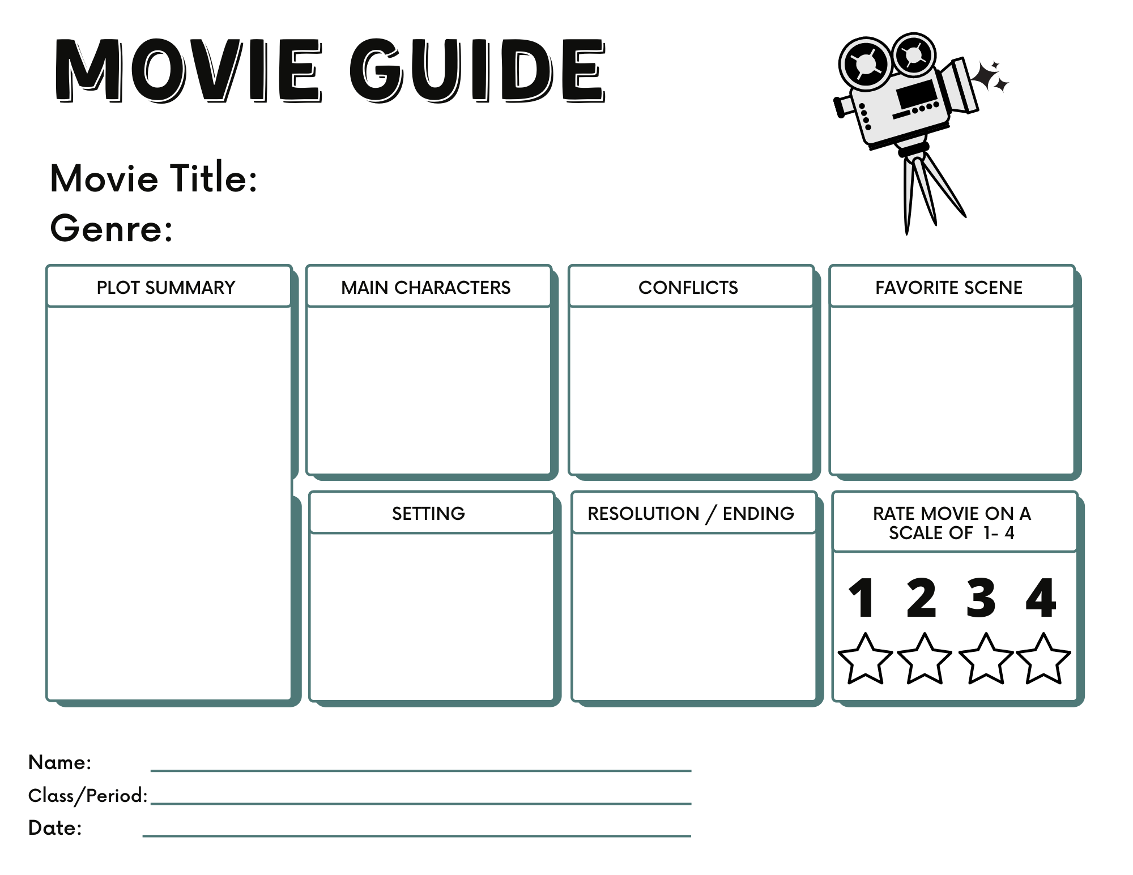
Type Here
Type Here
Type Here
Type Here
Type Here
Type Here
Type Here
Type Here
Type Here
Click on the star and use “fill color”

Slide 2
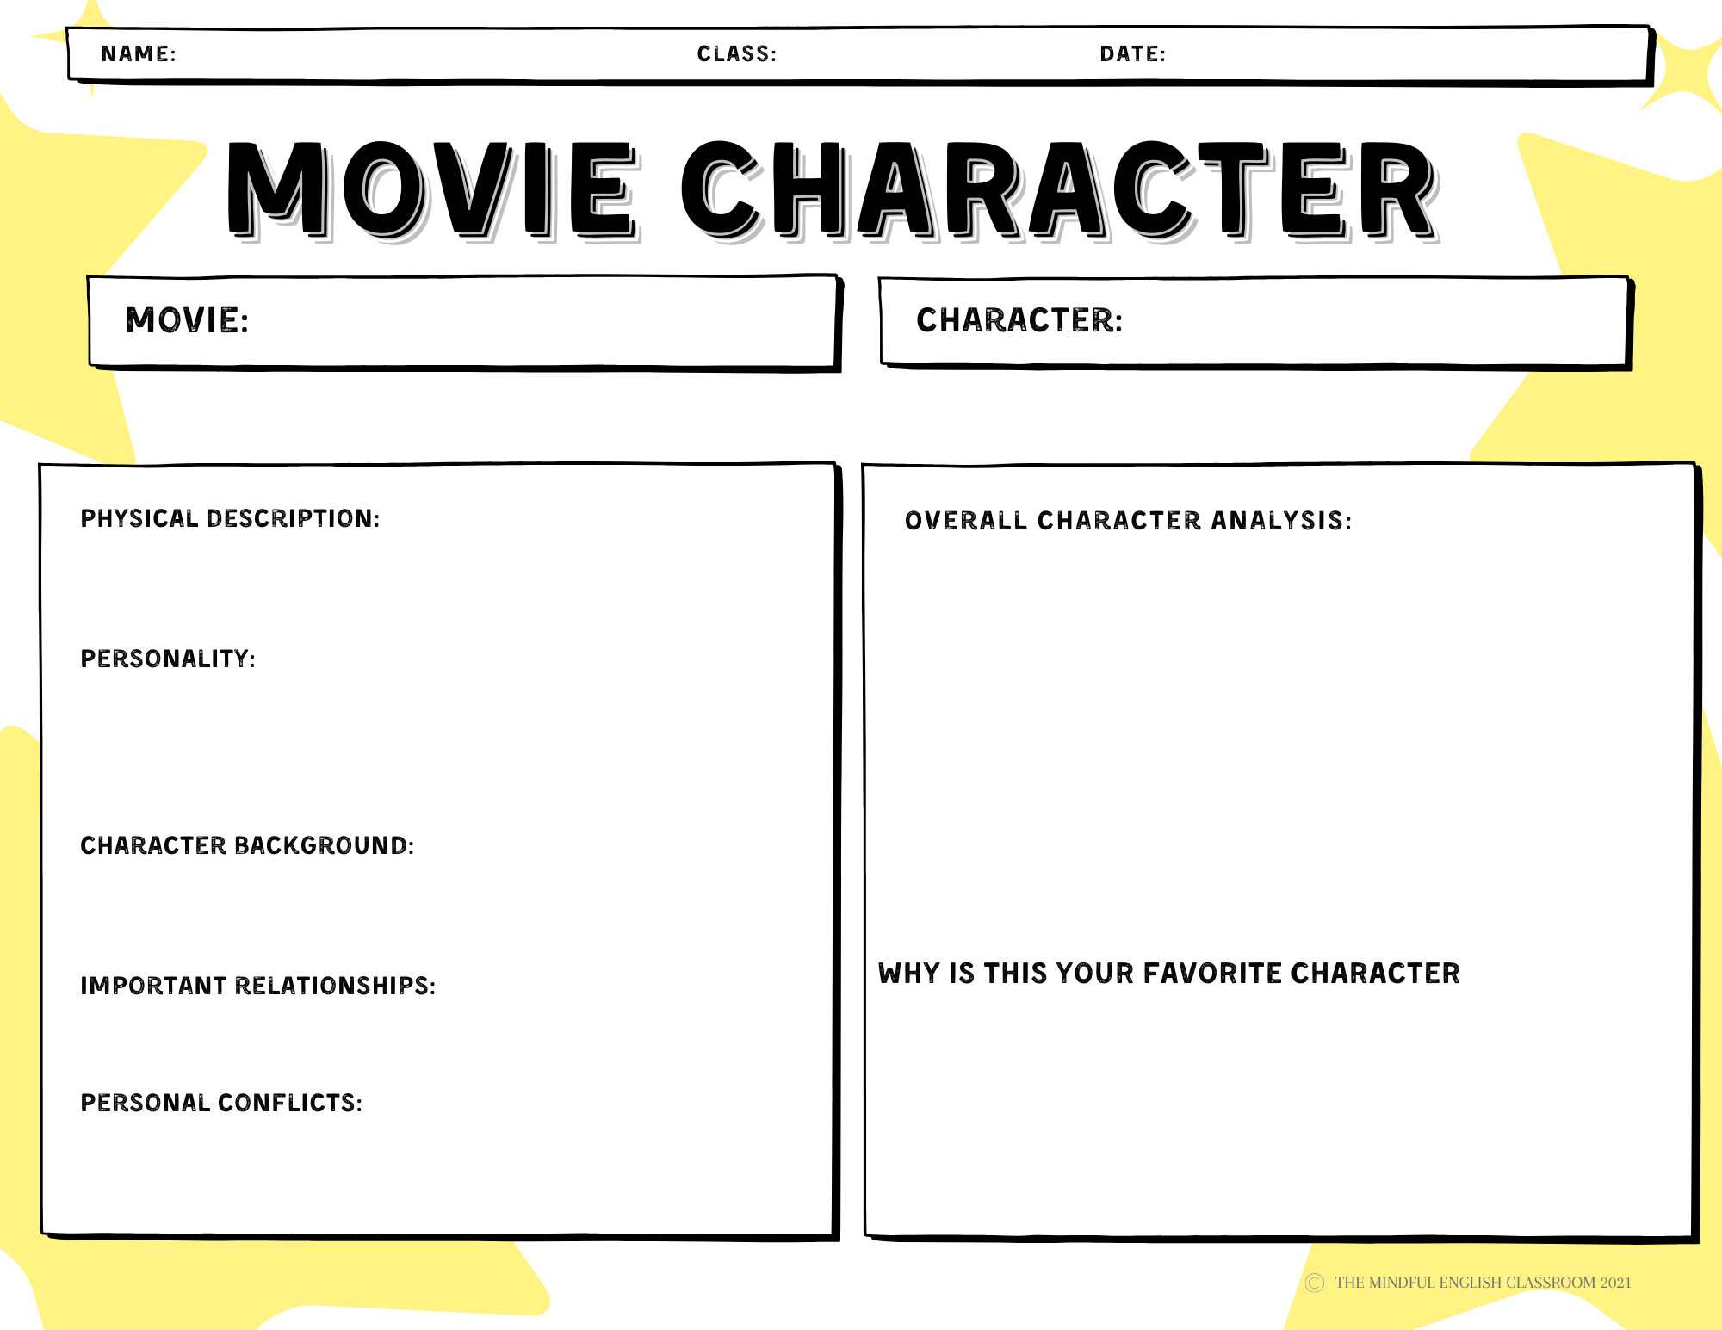
Type Here
Type Here
Type Here
Type Here
Type Here
Type Here
Type Here
Type Here
Type Here
Type Here

Slide 3
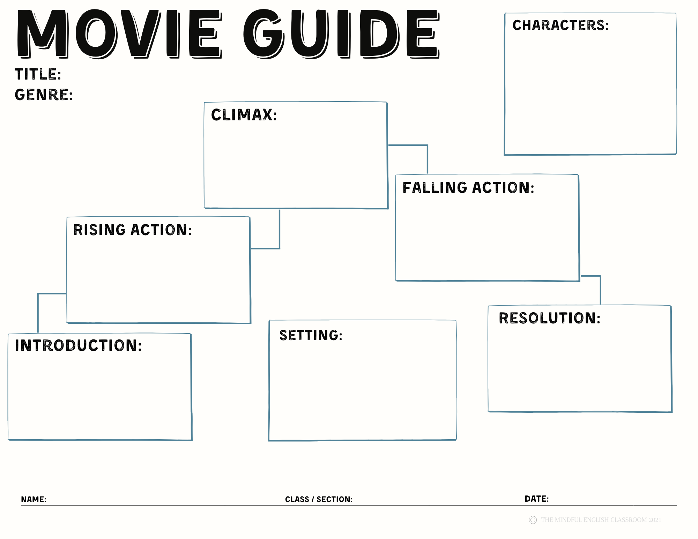
Type Here
Type Here
Type Here
Type Here
Type Here
Type Here
Type Here
Type Here
Type Here
Type Here

